Slide 2
Source Environment Analysis 101

Slide 4
Imagine 1 bright star with faint neighbouring stars

Slide 7
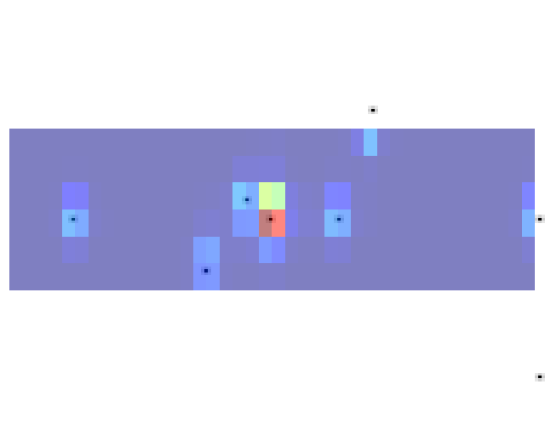

Slide 8
Star Mapper detects the bright star

Slide 9
saves the read-out from the CCD in a window around the star

Slide 10
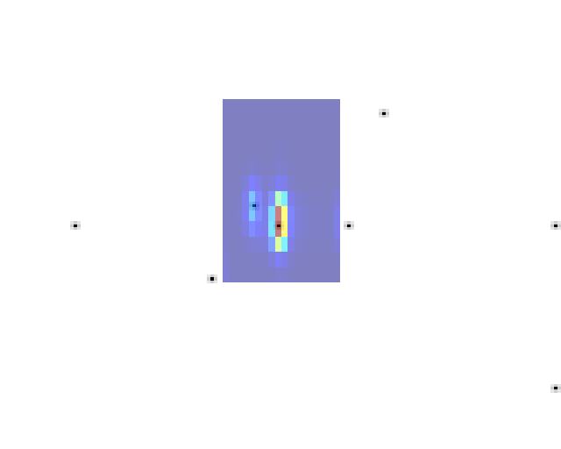

Slide 11
Detection data used to read out from the Astrometric Field CCDs

Slide 12
Higher resolution, but smaller window around the star

Slide 13
However …

Slide 14
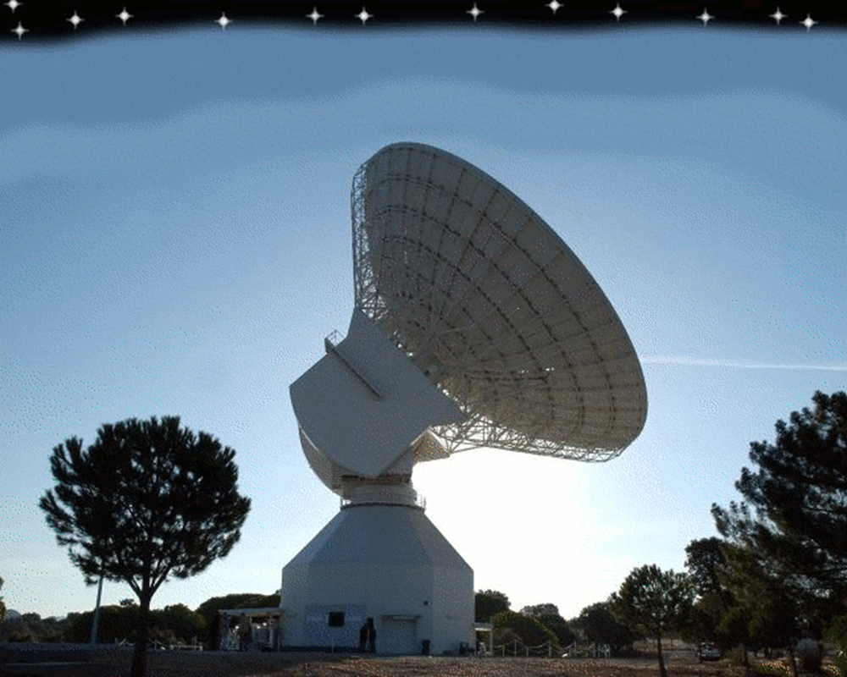

Slide 15
We have to get the data back to Earth

Slide 16
there are
many stars

Slide 17
and limited
bandwidth

Slide 18
the data must be compressed

Slide 19
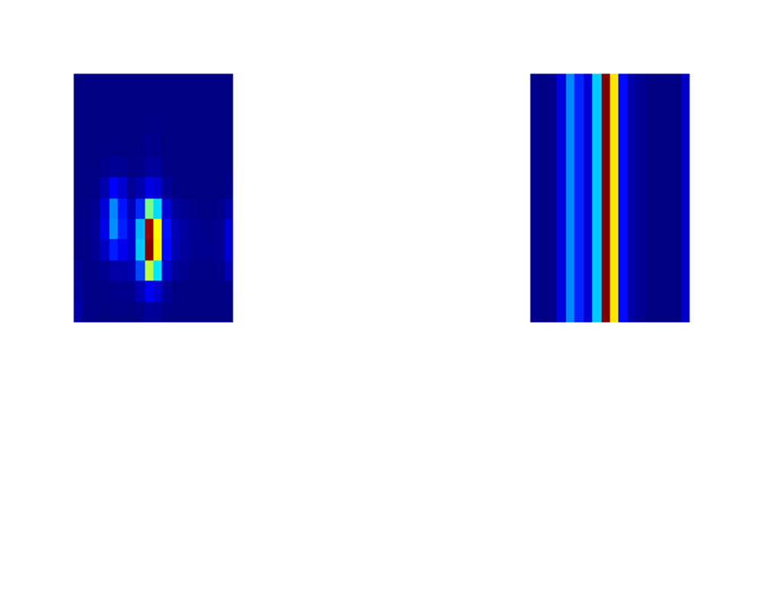

Slide 20
For all but the very brightest stars the windows are binned

Slide 21
216 pixels
becomes 18

Slide 22
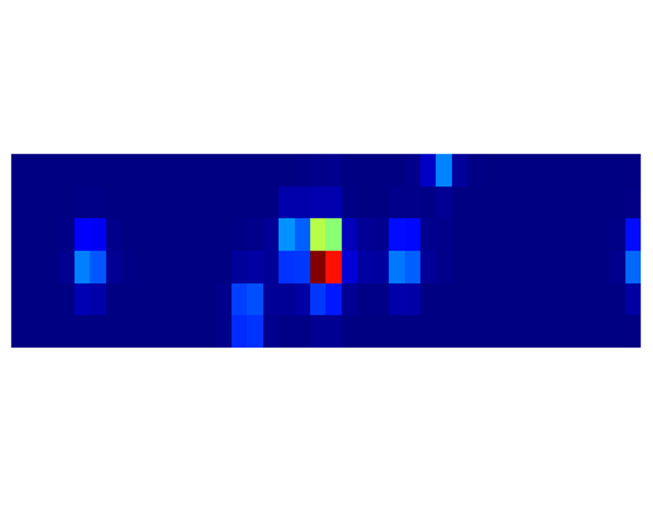

Slide 23
The Star Mapper windows

Slide 24
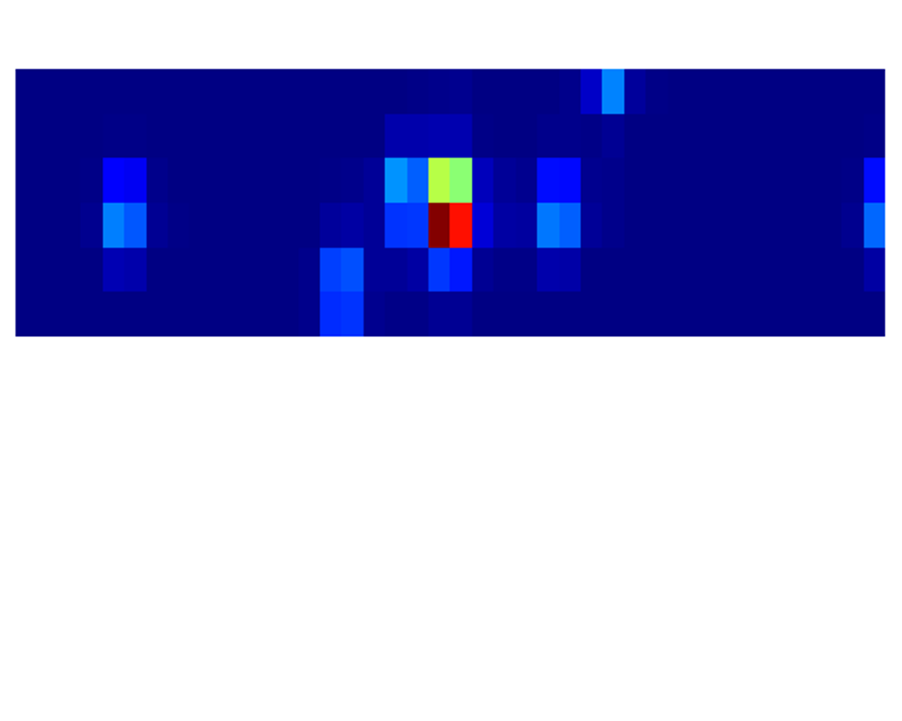

Slide 25
must also be binned

Slide 26
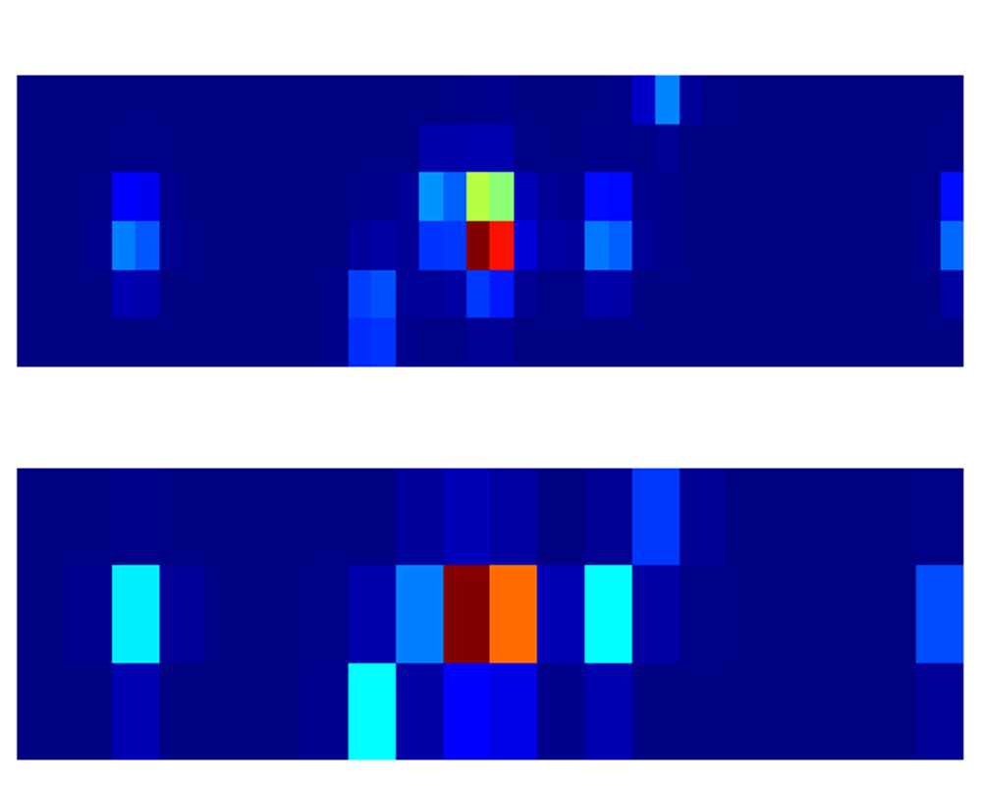

Slide 28
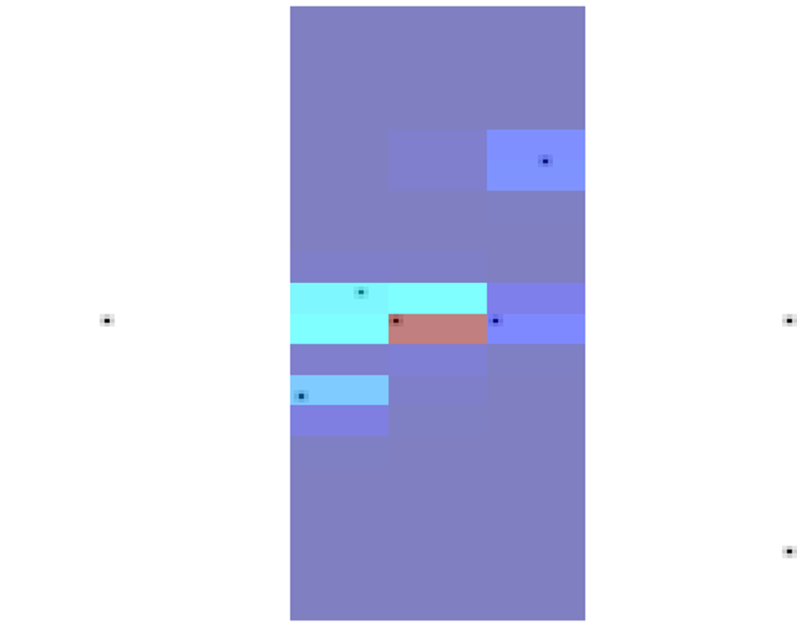

Slide 29
Later Gaia will see the star again

Slide 30
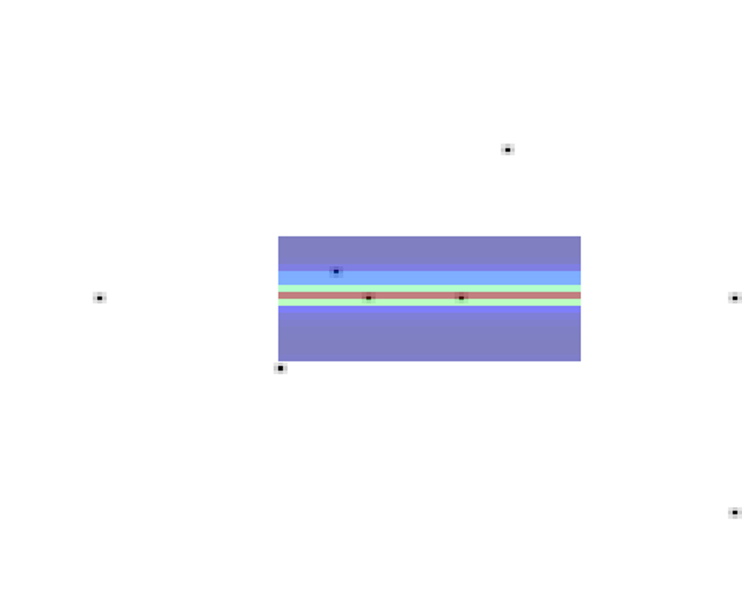

Slide 31
at this later time the CCD will be at a different angle

Slide 32
with respect to the star

Slide 33
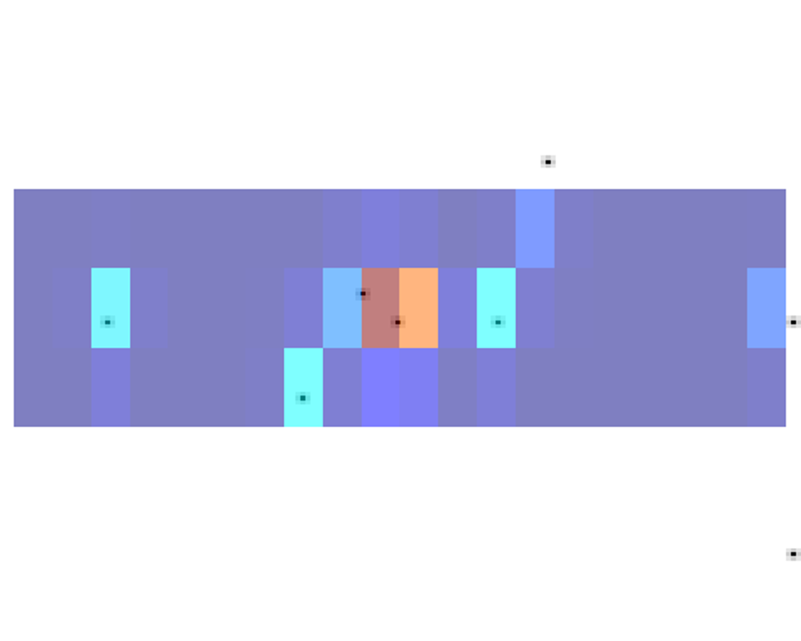

Slide 34
on average Gaia will see

Slide 35
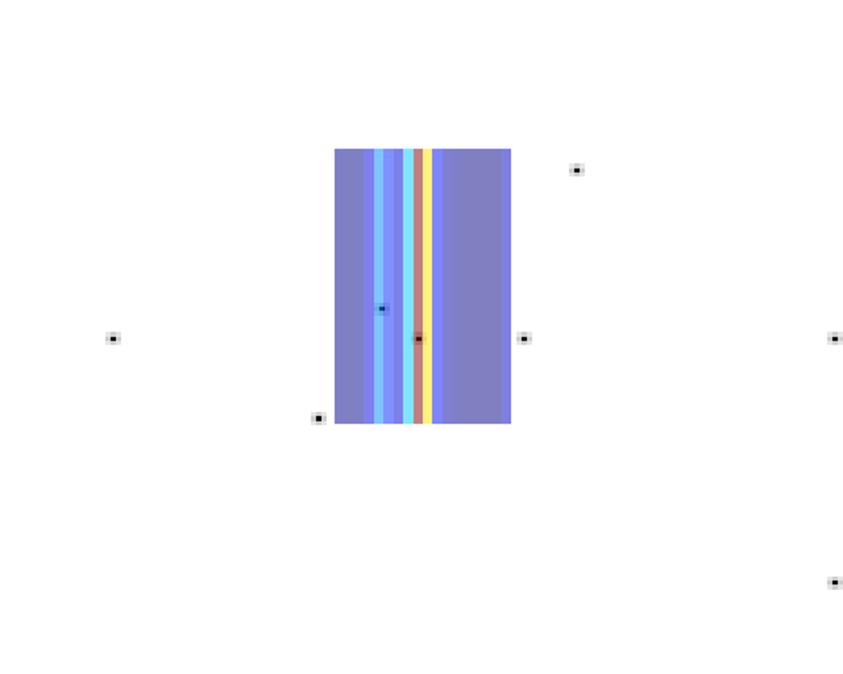

Slide 36
each star 85 times

Slide 37
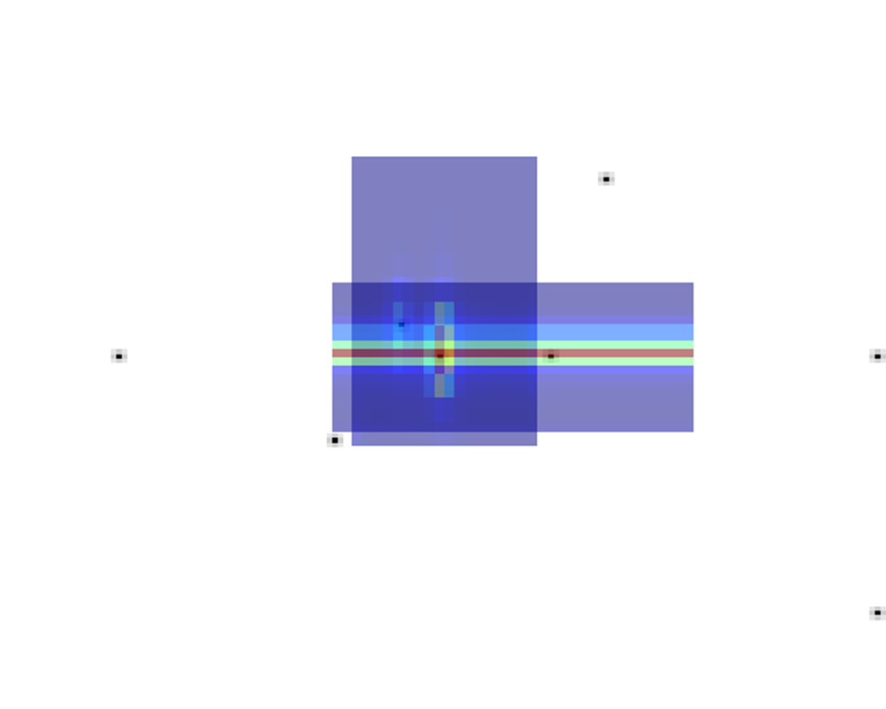

Slide 38
We can combine windows from the same star

Slide 39
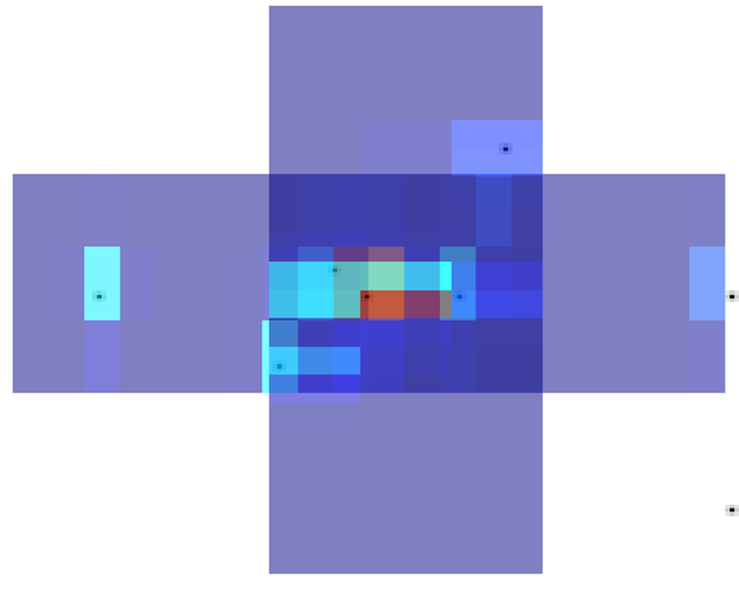

Slide 40
to try, to work out

Slide 41
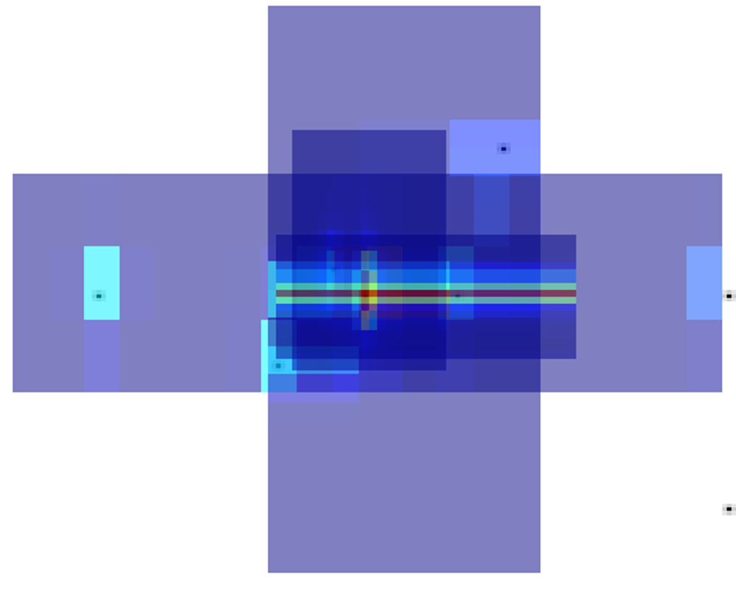

Slide 42
where the light is coming from

Slide 43
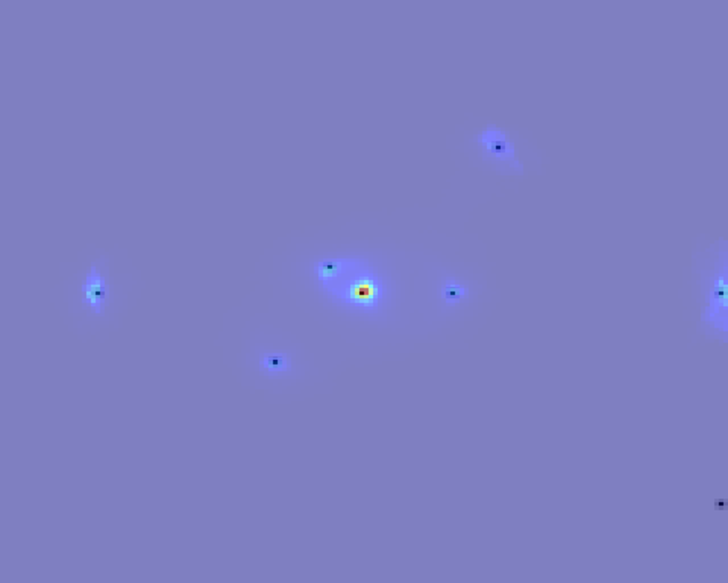

Slide 44
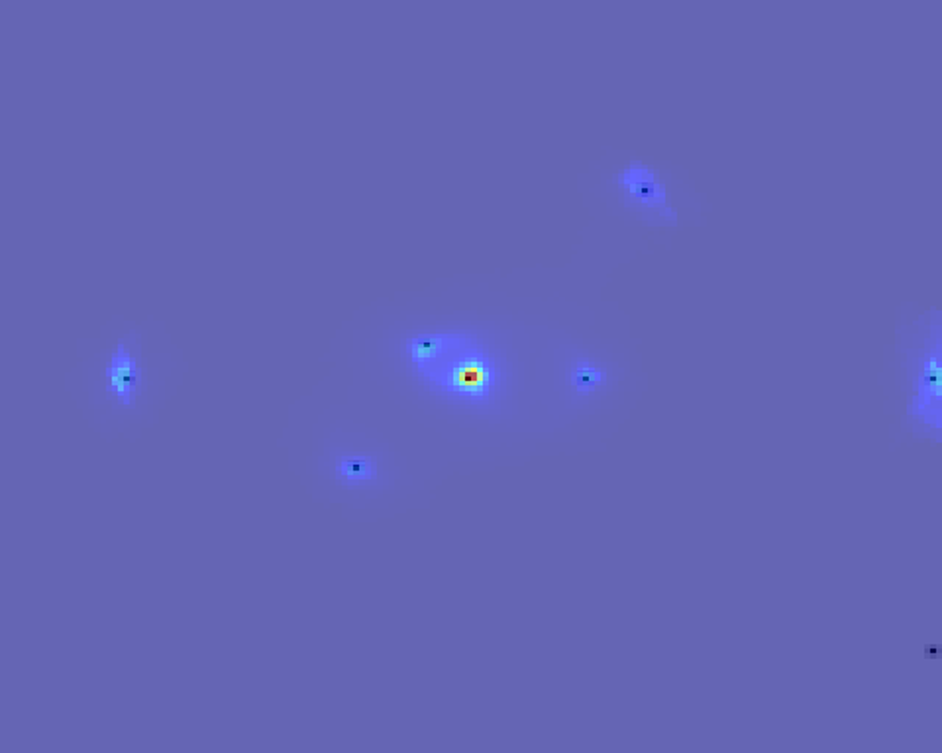

Slide 45
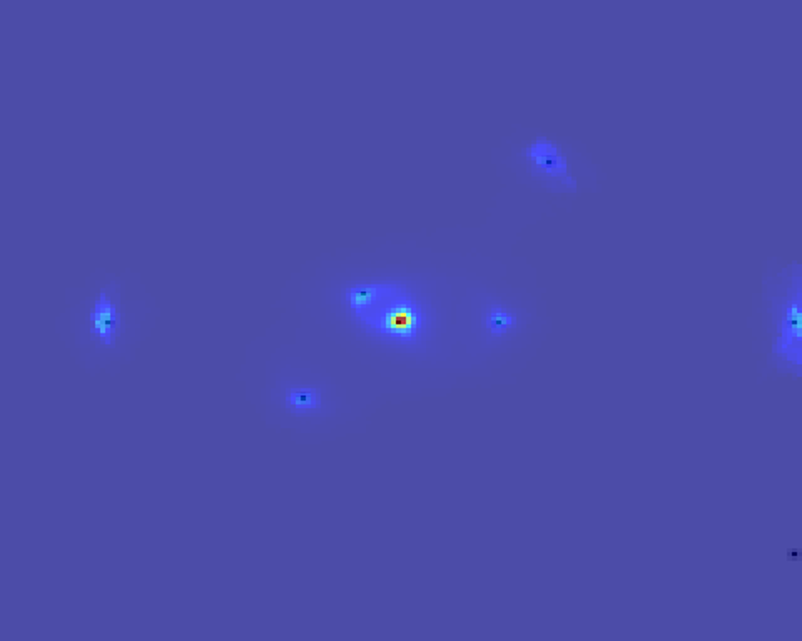

Slide 46
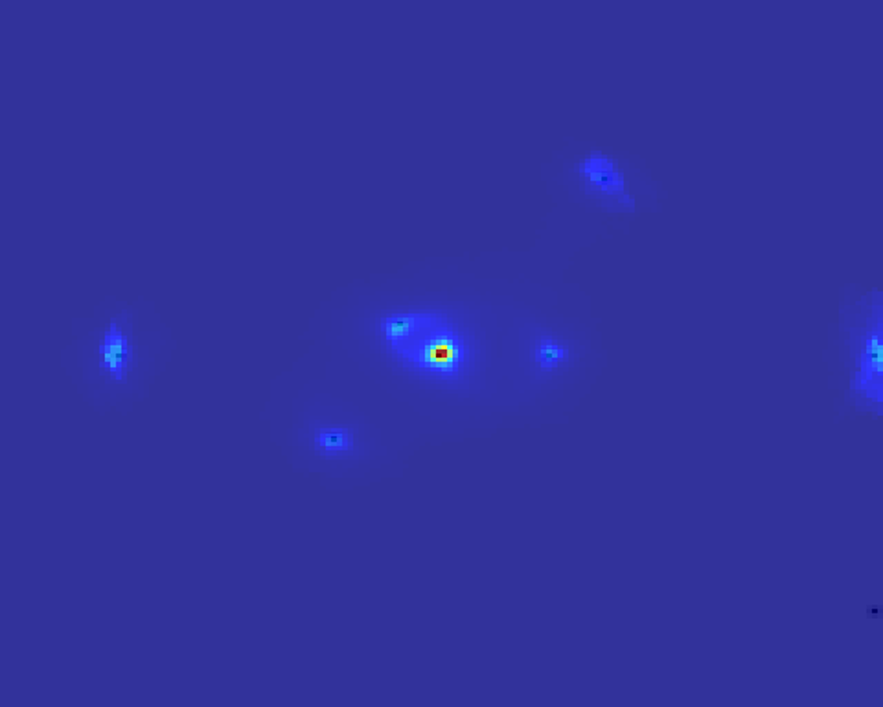

Slide 47
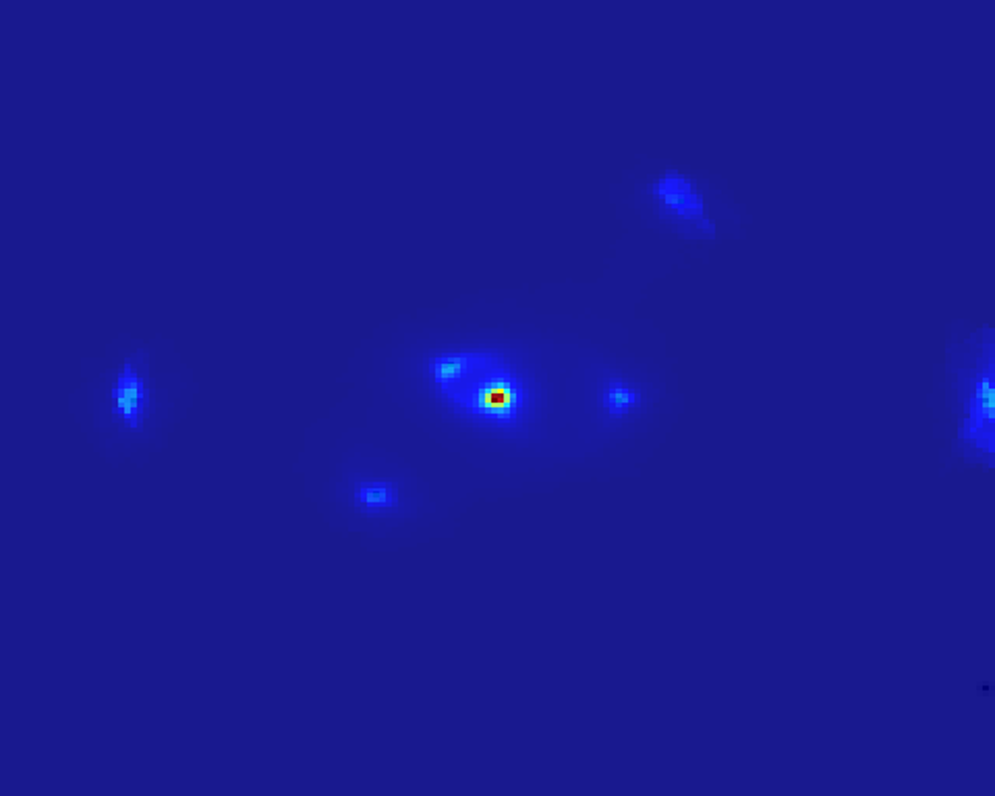

Slide 48
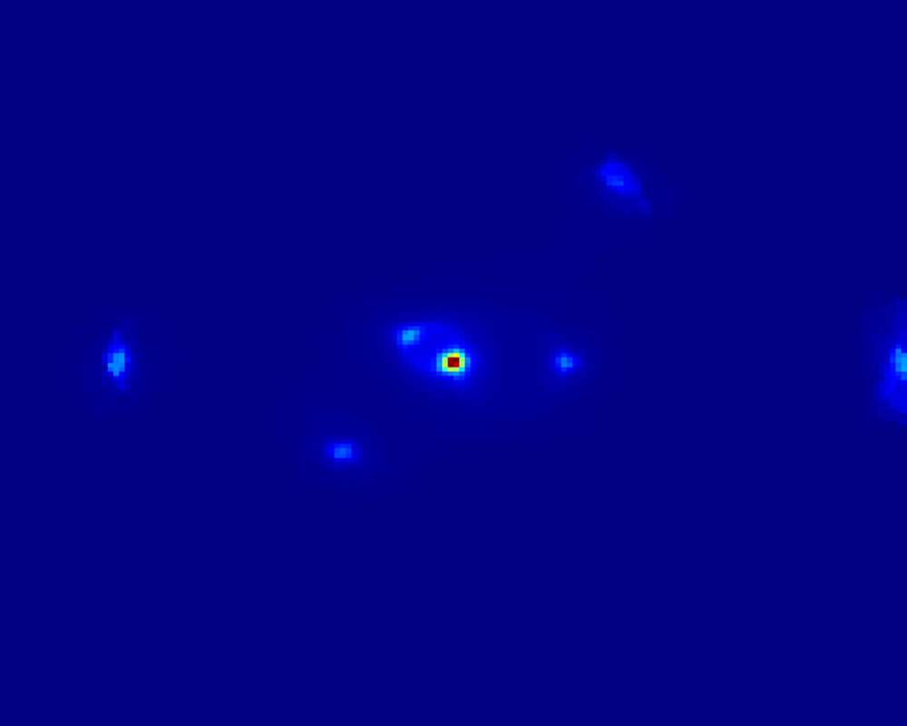

Slide 49
In order to discover the bright star’s faint neighbours

Slide 50
In order to discover the bright star’s faint neighbours

